Slide 1

Supplementary Live Session Week 3
MET CS 682
Information Systems
Analysis and Design
Dawson Williams
Last Updated 1/22/24

Slide 2
Agenda
Methods & Strategies in Organizing & Gathering Requirements
User Stories
GUI Wireframes
State Transition Diagrams

Slide 3
Detailed Requirements Overview
Before one designs and builds something, one needs to clearly understand what that “something” is to be. This is referred to as the requirements, and the process of gaining this understanding is called requirements analysis.
Ability to elicit the correct and necessary system requirements from the stakeholders (Whitten, 2007) Specify requirements in a manner understandable to both stakeholders and system builders.
The hardest single part of building a software system is deciding precisely what to build. No other part of the conceptual work is as difficult as establishing the detailed technical requirements, including all the interfaces to people, to machines, and to other software systems. No other work so cripples the resulting system if done wrong. No other part is more difficult to rectify later. Fred Brooks (Whitten, 2007)

Slide 4
Importance Of Requirements
Gathering Requirements:
Expressing clearly what customers want and need!
For many applications narrative text needs to be supplemented by figures of various kinds (GUI, State Transition, etc).
Design the system to accommodate the requirements.
Consider how the organization of requirements reflects the design.
Program the code to implement the requirements
How do we trace back code to the requirements?
Test the system to validate that the application satisfies the requirements.
Is everything implemented the way it was specified, anything missed, anything added?
(CS682 Module 3)

Slide 5

Systems Analysis Methodology
Sample Systems Analysis Document
Mission Statement/System Overview
User Stories (WHAT)
Functional Requirements (WHAT)
Detailed Use Cases
Graphical User Interface (GUI) Mockups
Storyboards—State Transition Diagrams
Quality Requirements (HOW)
Constraints (HOW)

Slide 6
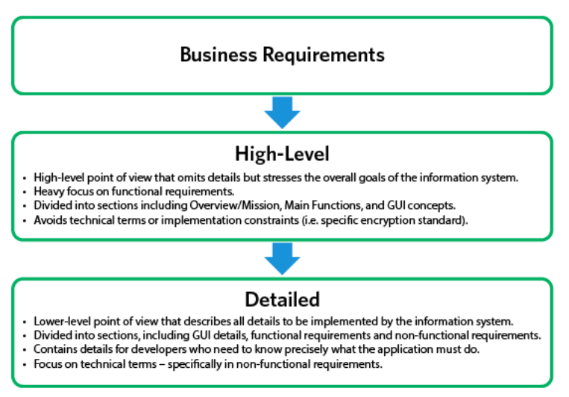
Requirements Levels

Slide 7
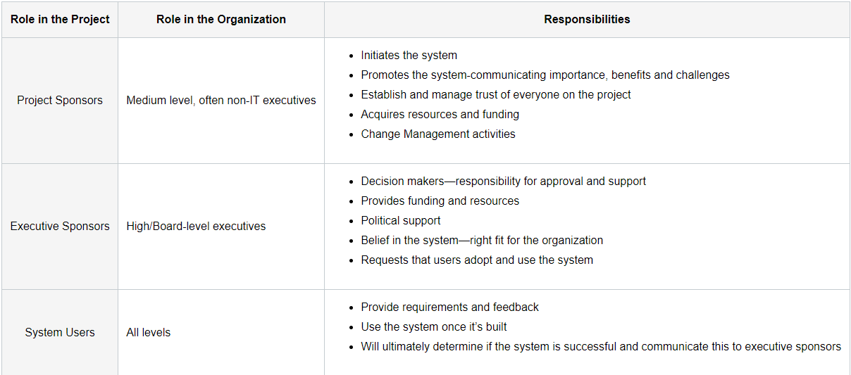
Identifying Stakeholders
Please see module on user group selection and the interview process

Slide 8
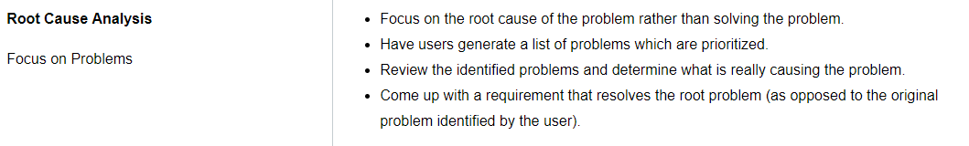
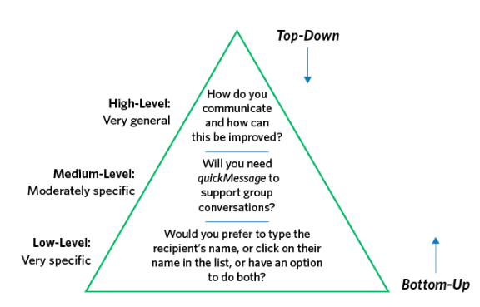
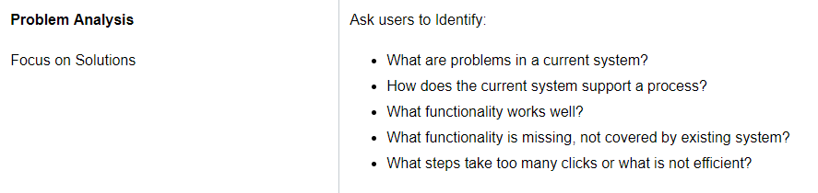
Requirements Gathering Strategies

Slide 9
Detailed Requirements Overview (Context of Assignment 3)
Part 1. Mission Statement/Overview
Part 2: User Stories
Part 3: Functional Requirements
Part 4: Use Cases
Part 5 & 6 State Transition Diagram
Part 7: GUI Sketches
Part 8: Non-Functional Requirements

Slide 10
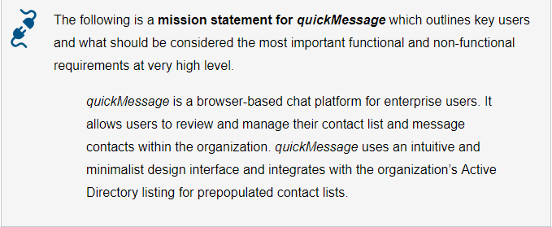
Mission Statement/System Overview
A high-level scope of the system which outlines the purpose of the application (in context of its intended market) as well as key users

Slide 11
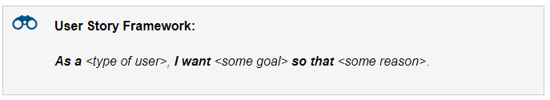
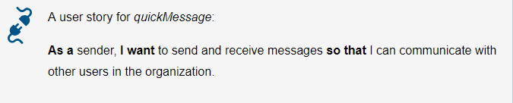
Requirements Analysis- User Stories
User stories are short, simple descriptions of a feature told from the perspective of the person who desires the new capability, usually a user or customer of the system.
A story may also be called an Epic because it encompasses large scope.
It’s all about the conversation-Interactions over processes and tools
https://www.mountaingoatsoftware.com/agile/planning-poker

Slide 12
User Stories
Detail can be added to user stories in two ways:
Disaggregation: By splitting a user story into multiple, smaller user stories.
By adding “conditions of satisfaction.”
As a sender, I want to send and receive messages so that I can communicate with other users in the organization.
Conditions of satisfaction:
Messages shall take no more than one second to display in the chat window.
quickMessage shall utilize HTML5 Web Sockets.

Slide 13
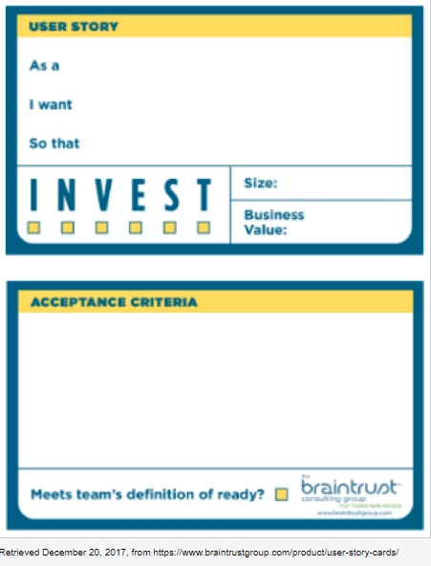
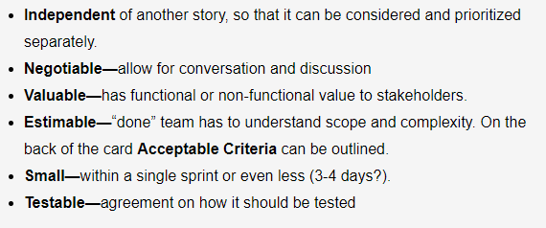
User Stories

Slide 14
Organizing by User Stories
Organizing principle | Advantages | Disadvantages
User Stories | Easy to understand Encourages conversations | Hard to trace to code Coverage is limited

Slide 15
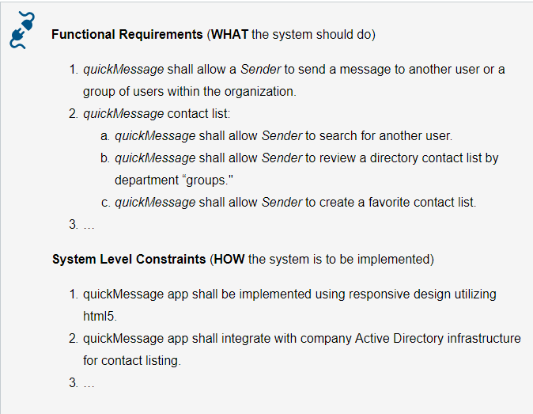
Functional & Non-functional Requirements

Slide 16
Non-Functional Quality Requirement vs. Non-Functional Constraint?
External interfaces that the application "talks to"
Hardware
Other software
Communication with external agents
Error conditions that the application must anticipate
System attributes
Reliability (measure of observed faults)
Availability (average up time)
Maintainability (cost to maintain)
Security (malicious and non-malicious compromise of data or functionality)
Performance
Speed (time to compete specified operations)
Storage (RAM, secondary, footprint)

Slide 17
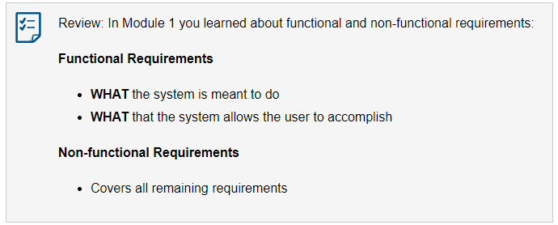
Functional & Non-functional Requirements

Slide 18
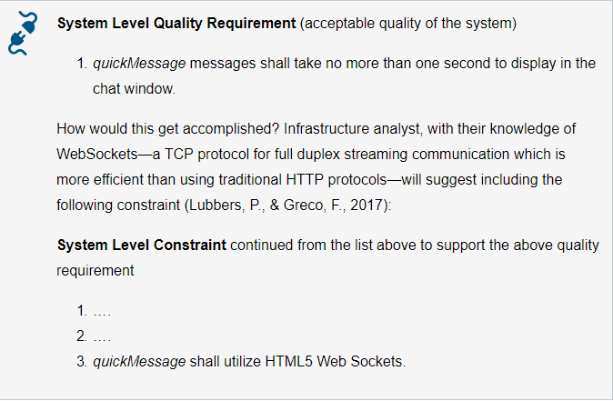
Functional & Non-functional Requirements

Slide 19
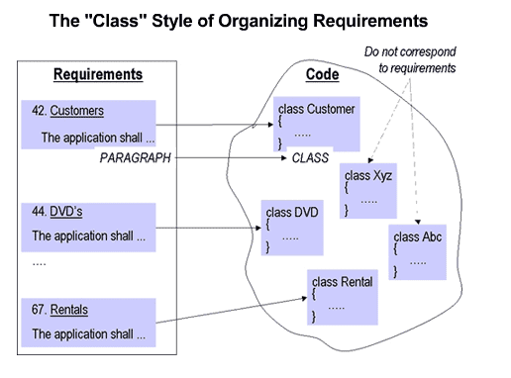
Organizing by Requirements
Organizing principle | Advantages | Disadvantages
By Function (Functional & Non Functional Requirements) | High Level Maps well to why we are building the application Easy to understand Focused on the business aspects of the system operations Detailed Helps system builders understand the constraints of the system at a high level | Hard to trace to code Hard to locate random requirement Coverage is limited

Slide 20
Graphical User Interfaces
User Dialog: a specification of how user moves from window to window or page to page (state transition model!), interacting with the application to perform useful work. (Whitten, 2007)
Interface specifications: Technical designs that document how system users are to interact with a system. (Whitten, 2007)
Customers commonly conceive of an application by visualizing its graphical user interface (GUI)
Balance: Intuitive minimalism vs. Functionality/training
Principles for User Interface Design
Content Awareness
User Awareness
Layout
Aesthetics (how pleasant is it to look at)
Predictability, Consistency, and Usability

Slide 21
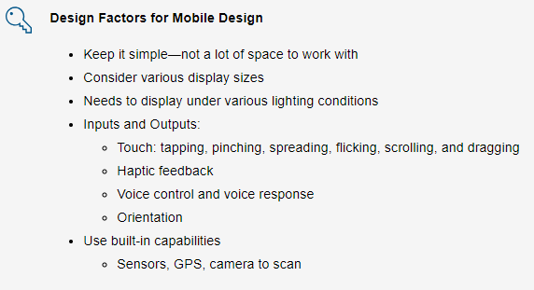
Graphical User Interfaces

Slide 22
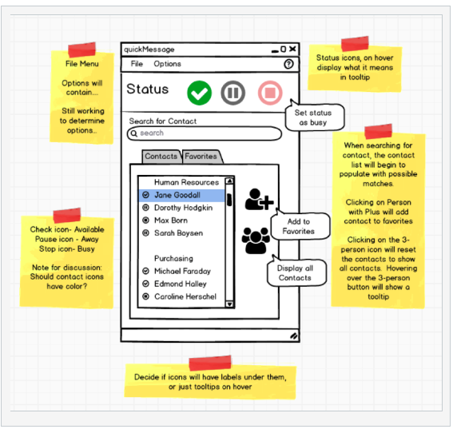
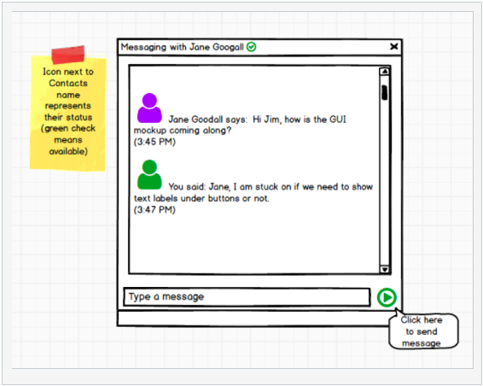
Graphical User Interfaces

Slide 23
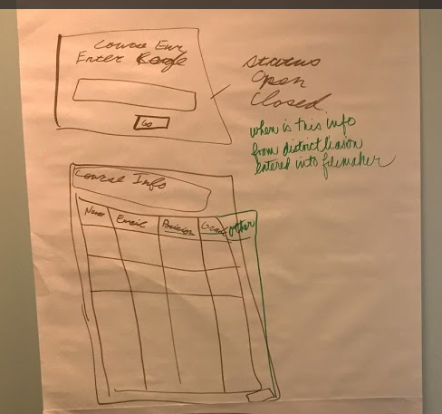
Organizing by GUI
Organizing principle | Advantages | Disadvantages
By GUI | Easy to understand Prototype of what the interface will look like “Picture is worth a thousand words” | Not every function appears in a GUI Functionality of GUIs overlap Hard to trace to design and code
Checklist:
Does the GUI take into account tradeoffs of Principles for User Interface Design (Content Awareness, User Awareness, Layout, Aesthetics, Predictability, Consistency, and Usability)?
Is the GUI consistent with other requirements elements—functional requirements, constraints, use cases.
Are all the functionalities understandable? If not add notes.
(CS682 Module 3)

Slide 24
Unified Modeling Language (UML)
The Unified Modeling Language (UML) is a set of modeling conventions that is used to specify or describe a software system in terms of objects. (Whitten, 2007)
Graphical notation for expressing object-oriented analysis and design.
Modern tool bag for systems analysis.
Easy to understand not only by system developers, but by customers as well.
“Is this what you want to be developed?”
Some parts of UML are accessible to the layman, others not.
Can be used to show varying degrees of complexity
verify and document application requirements
support a visual representation of an application design.
The level of detail and complexity should be appropriate to the anticipated audience. http://www.omg.org/
https://www.omg.org/spec/UML/2.5.1/PDF

Slide 25
State Transition Diagram
How to visually see a Use Cases and GUIs?
Is there any major piece that we are missing?
Can we see a top-level map of our system?
State Transition Diagram: A tool used to depict the sequence and variation of screens that can occur during a user session. (Whitten, 2007)
The Unified Modeling Language (UML) behavioral state machine is a dynamic model that shows the different states through which a single object (system for now) passes during its life in response to events.

Slide 26
State Transition Diagram
State: When a particular GUI is present or the application can be considered to be in a particular state, phase, operating mode.
Sub-State: A state which has additional state and transition detail.
Transition: Changing from one GUI state to another is called transition and is denoted by an arrow starting from the initial state and pointing to the new state.
Event: The arrow is labeled with the name of an action which causes the transition. This action is called an event (A mouse click!).

Slide 27
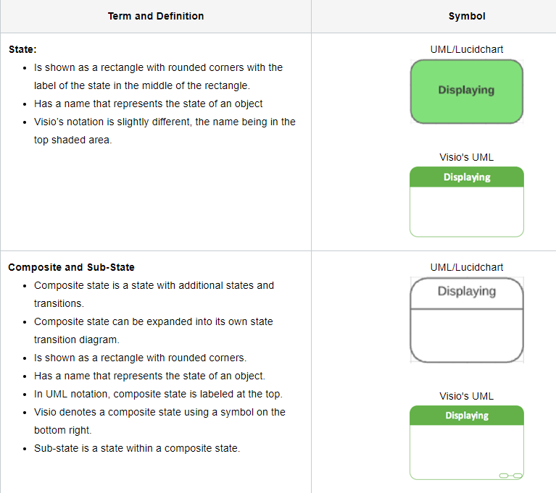
State Transition Diagram Symbols

Slide 28
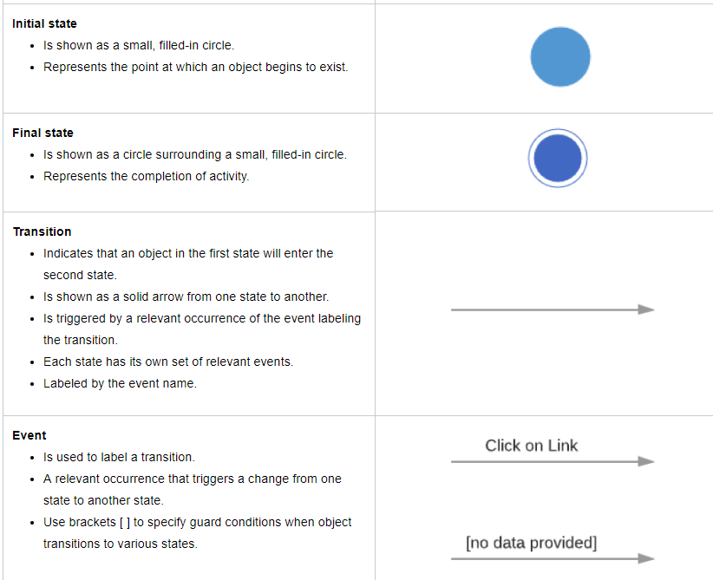

Slide 29
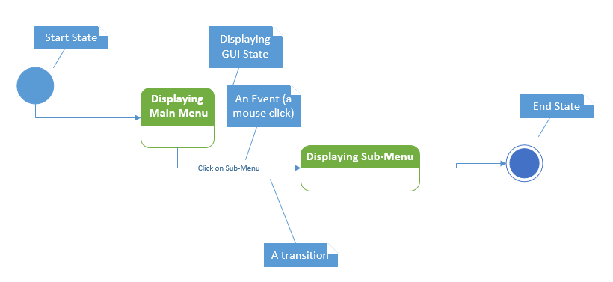
State Transition Diagram

Slide 30
Ok… but where do I start?
Begin by reviewing all of the requirements which we have constructed so far, including functional requirements, use cases, and GUI diagrams.
If you are really stuck… pick a system level use case and map out states (what system does) and transitions (what user does)
… however…..
States and transitions within a state transition diagram should not have to follow the order of the use cases.
The flexibility of a state transition diagram allows for an overview over a sequence diagram, which we will learn later in the course.

Slide 31
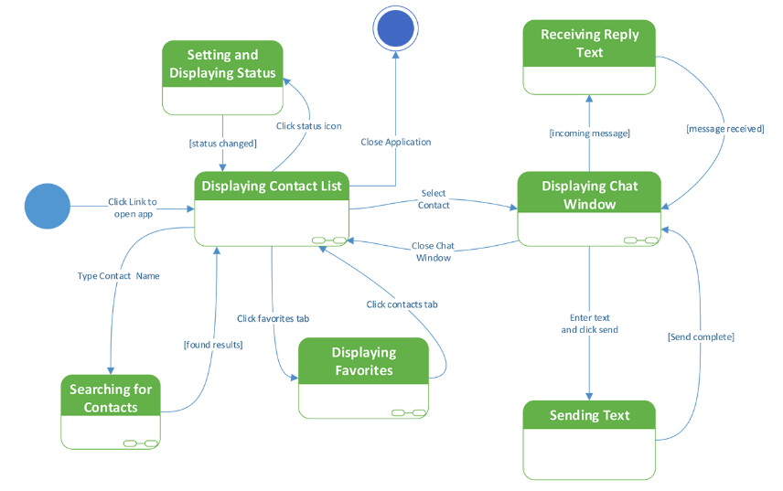
State Transition Diagram Example

Slide 32
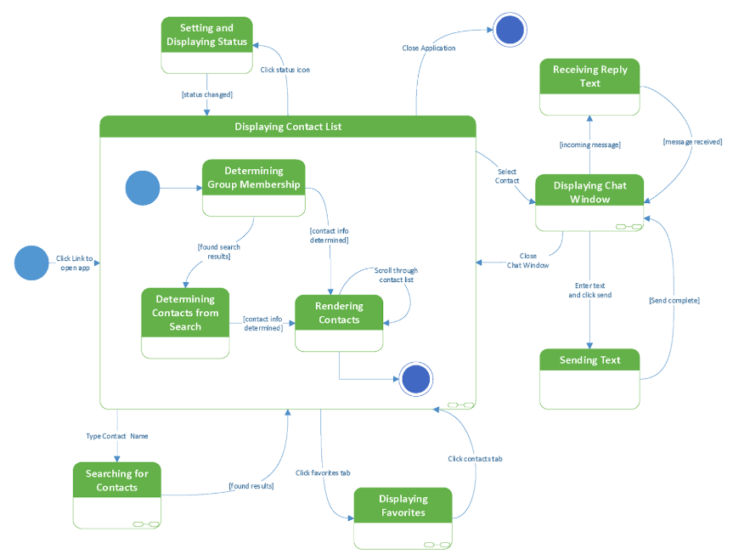
Please see example in Module how use case was used to expand sub-state

Slide 33
Organizing by State Transition Diagram
Organizing principle | Advantages | Disadvantages
State Transition Diagrams | Used to depict the sequence and variation of screens that can occur during a user session Can help uncover missing events, transitions, and states in requirements | May not be as easy to understand for users/stakeholders without explanations May not be easy to trace to code (state transition diagram specifically) Coverage is limited
Guidelines:
Decide on scope
left-to-right and top-to-bottom, the initial state (top left), final state (bottom right)
Every state, including composite and sub-state, must have an event transition to it and out of it with the exception of the initial and final states designated by circles.
Is an artifact an event or as a state? A general guideline is that a state has a much longer time duration than an event.
Not all events are possible in each state. Transitions from start state and to end state may not have event labels on them.
Be sure that all guard conditions are mutually exclusive (not overlapping). For example, [sent] and [not sent].

Slide 34
References
Braude, E. Polnar J (2018). Module 3 IT Systems & Introduction to Process. Metropolitan College, Boston University, Boston, MA.
Whitten, B. (2007). Systems analysis & design methods. (7th ed.). New York, NY: McGraw-Hill Irwin.
Dennis, A., Wixom, B. H., Tegarden, D. (02/2015). Systems Analysis and Design: An Object-Oriented Approach with UML, 5th Edition
Cohn, M. (n.d.). Planning Poker: An Agile Estimating and Planning Technique. Retrieved August 12, 2017, from https://www.mountaingoatsoftware.com/agile/planning-poker
Lubbers , P., & Greco, F. (n.d.). HTML5 WebSocket: A Quantum Leap in Scalability for the Web. Retrieved December 13, 2017, from http://www.websocket.org/quantum.html

